Slide 1
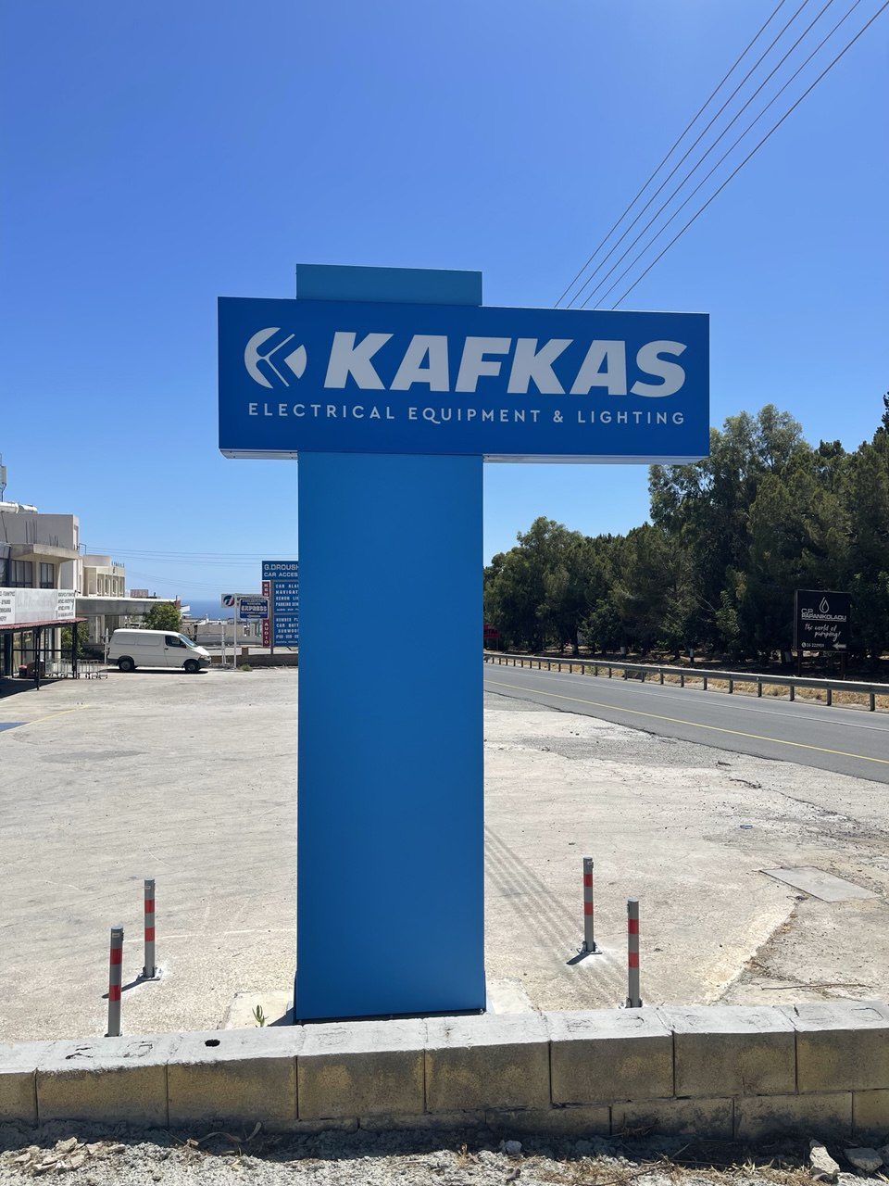
Queues Crash Course
Apache Kafka: Ecosystem

Slide 2
In the Part II:
Stream processing and EventSourcing with Kafka Streams
Kafka Connect
Schema Registry
Cross-Cluster Data Replication with MirrorMaker

Slide 3
Kafka Streams and KSQL
Stream processing and EventSourcing

Slide 4
Processor Topology Overview
Directed Acyclic Graph
Defines the flow of data through stream processing nodes.

Slide 5
Processor Topology Overview
Components
Sources: Nodes that read data from Kafka topics.
Processors: Nodes that apply operations to transform the data.
Sinks: Nodes that write the processed data back to Kafka topics.
Example
A source reads data from the "input" topic.
A processor filters and transforms the data.
A sink writes the transformed data to the "output" topic.

Slide 6
Processor Topology
Processor
Sink
Source
Processor
Processor
Sink
Processor
Source
Processor
Table

Slide 7
Processor Topology
Processor
Producer
Consumer
Processor
Processor
Producer
Processor
Consumer
Processor
Table

Slide 8
Kafka Streams is Java App
Implementing source + processor + sink

Slide 9
Example Topology Code
builder = new StreamsBuilder();
sourceStream = builder.stream("input-topic");

Slide 10
Example Topology Code
builder = new StreamsBuilder();
sourceStream = builder.stream("input-topic");
sourceStream
.filter((key, value) -> value.contains("filter"))

Slide 11
Example Topology Code
builder = new StreamsBuilder();
sourceStream = builder.stream("input-topic");
sourceStream
.filter((key, value) -> value.contains("filter"))
.mapValues(value -> value.toUpperCase())

Slide 12
Example Topology Code
builder = new StreamsBuilder();
sourceStream = builder.stream("input-topic");
sourceStream
.filter((key, value) -> value.contains("filter"))
.mapValues(value -> value.toUpperCase())
.to("output-topic");

Slide 13
KStream
Abstraction for a continuous stream of records.
Each record is a key-value pair.
Represents an unbounded dataset.
Supports stateless and stateful operations.
KStream<String, String> stream =
builder.stream("topic");

Slide 14
Operations on KStream
Peek
Peeking at the records as they pass through the stream.
Map and MapValues (transform)
map: transforms each record into a new record with potentially different key and value.
mapValues: transforms only values.
Filter
Removes records from stream by condition.

Slide 15
Operations on KStream
kstream.peek((key, value) -> println(key, value))
kstream.map((key, value) ->
KeyValue.pair(key.toUpperCase(), value.toUpperCase()))
kstream.mapValues(value -> value.toUpperCase())
kstream.filter((key, value) -> value.contains("filter"))

Slide 16
KTable
Abstraction of a changelog stream, where each record represents an update.
Represents a snapshot of data at a given time.
Supports stateful operations.
Uses local storage for maintaining state.
KTable<String, String> table =
builder.table("input-topic");

Slide 17
KTable
Consumes single topic
Do not stream results
Needs materialized state store
The cache inside: flush every 30s
KTable: works on topic partition
GlobalKTable: works on the whole topic

Slide 18
KTable
x
1
x
1

Slide 19
KTable
x
1
x
1
y
2
y
2

Slide 20
KTable
x
3
x
1
y
2
x
3
y
2

Slide 21
KTable
x
3
x
1
y
2
x
3
y
2

Slide 22
KTable
x
3
x
1
y
2
x
3
z
4
y
2
z
4

Slide 23
KTable
x
6
x
1
y
2
x
3
z
4
x
5
x 6
z7
y8
y
8
z
7

Slide 24
KTable
x
9
x
1
y
2
x
3
z
4
x
5
x 6
z7
y8
x9
yA
zB
zC
y
A
z
C

Slide 25
Joins
Stream-Stream
2 events → 1 new event
join based on common key
Join waits for a given “window” time
Stream-Table
Stream-Table
Stream-GlobalTable
Table-Table

Slide 26
Joins example
KStream<String, String> joined =
stream1.join(
stream2,
(left, right) -> left + right,
JoinWindows.of(Duration.ofMinutes(5))
);

Slide 27
Types of joins for Stream-Stream
Inner
Produces result only if have left and right
Outer
Left + Right
Left + Null
Null + Right
LeftOuter
Left + Right
Left + Null

Slide 28
Types of joins for Stream-Table
No windowed (Table query is immediate)
Inner
Produces result only if have left and right
LeftOuter
Left + Right
Left + Null
Stream always Left (triggers event output)
KTables are timestamp driven
GlobalKTables are bootstrapped (read all at start)

Slide 29
Types of joins for Table-Table
No windowed (Table query is immediate)
The result is KTable, not Kstream
Types:
Inner
Outer
LeftOuter

Slide 30
Stateful operations (aggregations)
Operations that maintaining state
Need info from previous events
Like tables they need Materialized
Operations:
aggregate
reduce
count

Slide 31
Stateful operations (aggregations)
stream.groupByKey().count();
stream
.groupByKey()
.aggregate(
() -> 0L,
(key, value, agg) -> agg + value.length()
);

Slide 32
Aggregation windowing
Windowing is a technique to group records based on time intervals.
Kinds:
Tumbling
Hopping
Sliding
Session

Slide 33
Stateful operations (aggregations)
stream.groupByKey().count();
stream
.groupByKey()
.windowedBy(TimeWindows.of(Duration.ofMinutes(5)))
.aggregate(
() -> 0L,
(key, value, agg) -> agg + value.length()
);

Slide 34
Hopping window
10 min
10 min
10 min
advance 5 min
10 min
10 min
10 min
10 min

Slide 35
Hopping window
1
2
3
4
5
6
7
8
9
A
B
C

Slide 36
Hopping window
1
2
3
4
5
6
7
8
9
A
B
C

Slide 37
Hopping window
1
2
3
4
5
6
7
8
9
A
B
C

Slide 38
Hopping window
1
2
3
4
5
6
7
8
9
A
B
C

Slide 39
Thumbling window
advance = window size
10 min
10 min
10 min
10 min

Slide 40
Tumbling window
1
2
3
4
5
6
7
8
9
A
B
C

Slide 41
Tumbling window
1
2
3
4
5
6
7
8
9
A
B
C

Slide 42
Thumbling window
stream
.groupByKey()
.windowedBy(
TimeWindows
.of(Duration.ofMinutes(10))
)
.count();

Slide 43
Hopping window
stream
.groupByKey()
.windowedBy(
TimeWindows
.of(Duration.ofMinutes(10))
.advanceBy(Duration.ofMinutes(5))
)
.count();

Slide 44
Sliding window
stream
.groupByKey()
.windowedBy(
SlidingWindows
.ofTimeDifferenceWithNoGrace(
Duration.ofMinutes(5)
)
)
.count();

Slide 45
Session window
stream
.groupByKey()
.windowedBy(
SessionWindows.with(Duration.ofMinutes(5))
)
.count();

Slide 46
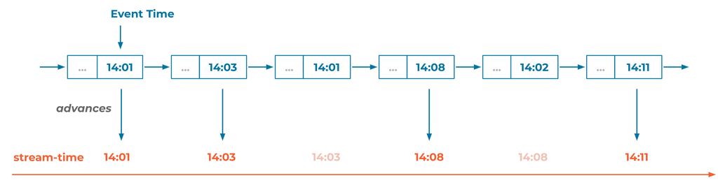
Stream Time

Slide 47
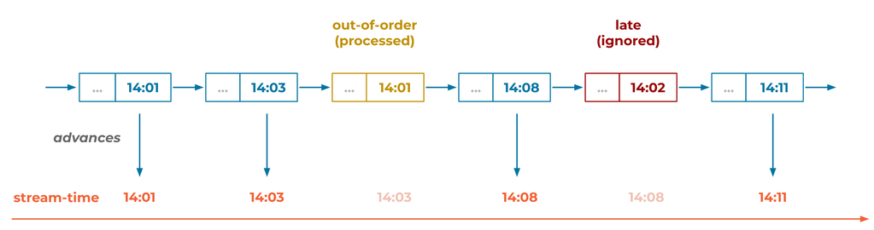
Grace period

Slide 48
Processor API
Low-level API for building custom stream processing logic.
When the DSL does not provide the required functionality.
Processor API offers more flexibility than the DSL.
Allows for fine-grained control over processing logic.
Can be integrated with the DSL.

Slide 49
Durability of Local State and Failover
Local storage used for maintaining state.
Local storage may be in-memory or disk based.

Slide 50
Durability of Local State and Failover
Local storage used for maintaining state.
Local storage may be in-memory or disk based.
Processor node maintains a changelog of state in special topic
Changelog is compacted to allow faster recovery
Upon failure, the whole state may be reconstructed from changelog

Slide 51
Durability of Local State and Failover
Local storage used for maintaining state.
Local storage may be in-memory or disk based.
Processor node maintains a changelog of state in special topic
Changelog is compacted to allow faster recovery
Upon failure, the whole state may be reconstructed from changelog
To speedup failover, there are standby processor nodes
Standby nodes only consume changelogs and maintain state

Slide 52
Durability of Local State and Failover
Local storage used for maintaining state.
Local storage may be in-memory or disk based.
Processor node maintains a changelog of state in special topic
Changelog is compacted to allow faster recovery
Upon failure, the whole state may be reconstructed from changelog
To speedup failover, there are standby processor nodes
Standby nodes only consume changelogs and maintain state

Slide 53
ksqlDB
Kafka Streams with SQL

Slide 54
ksqlDB: Kafka Streams with SQL
KSQL is a SQL-based stream processing engine for Apache Kafka.
Simplifies data processing by writing streaming queries using SQL.
Easy to use with SQL-like syntax.
No need for complex coding.
Real-time continuous query execution.
By Confluent

Slide 55
Basic KSQL Queries: Create stream
CREATE STREAM pageviews(
viewtime BIGINT,
userid VARCHAR,
pageid VARCHAR
)
WITH (
kafka_topic='pageviews’,
value_format='DELIMITED’
);

Slide 56
Basic KSQL Queries: selecting and filtering
SELECT * FROM pageviews
WHERE pageid = 'home’
EMIT CHANGES;

Slide 57
Advanced KSQL Queries: Transformations
SELECT
userid,
UCASE(pageid) AS upper_pageid
FROM pageviews
EMIT CHANGES;

Slide 58
Advanced KSQL Queries: Tables
CREATE TABLE user_profiles (
userid VARCHAR,
regionid VARCHAR,
gender VARCHAR
)
WITH (
kafka_topic='user_profiles’,
value_format='JSON’,
key='userid’
);

Slide 59
Advanced KSQL Queries: Joins
SELECT
p.viewtime, p.userid,
p.pageid, u.regionid, u.gender
FROM pageviews p
LEFT JOIN user_profiles u ON p.userid = u.userid
EMIT CHANGES;

Slide 60
Aggregations and Windowing in KSQL
SELECT
pageid,
COUNT(*) AS view_count
FROM pageviews
GROUP BY pageid
EMIT CHANGES;

Slide 61
Windowed Aggregation
CREATE TABLE pageview_counts AS
SELECT
pageid,
COUNT(*) AS view_count
FROM pageviews
WINDOW TUMBLING (SIZE 1 HOUR)
GROUP BY pageid;

Slide 62
Session Windowing
SELECT
userid,
COUNT(*) AS session_count
FROM pageviews
WINDOW SESSION (5 MINUTES)
GROUP BY userid
EMIT CHANGES;

Slide 63
What if not Java and Scala

Slide 64
Alternatives
Apache Flink
Stateful Computations over Data Streams
Advanced, stateful, scalable processing
Apache Beam
SDKs for defining and executing data processing workflows
Unified batch/stream model
Materialize
Real-time materialized views

Slide 65
Apache Flink
Distributed stream and batch data processing framework
Standalone distributed system
Scale independently of Kafka
Flink can connect to many systems, not just Kafka
Flink jobs are not inherently tied to Kafka
Flexible for other data pipelines

Slide 66
Pure programming
Generic Producer/Consumer API for any language + State Storage
Python:
Faust (python-native stream processing library)
Confluent Kafka client
Golang:
Kafka-Go
Watermill
A Go library for working efficiently with message streams. It's not specific to Kafka but has a Kafka adapter.

Slide 67
Kafka Connect

Slide 68
What is Kafka Connect?
Framework for connecting Kafka with external systems
databases
key-value stores
search indexes
datalakes and storages
file systems
Purpose
Simplifies data integration and stream processing.
Provide scalable and reliable data pipelines.

Slide 69
Benefits and Use Cases
Benefits:
Easy to set up and configure.
Scalable and fault-tolerant.
Supports a wide range of connectors.
Use Cases:
Data migration between systems.
Real-time analytics.
ETL processes.

Slide 70
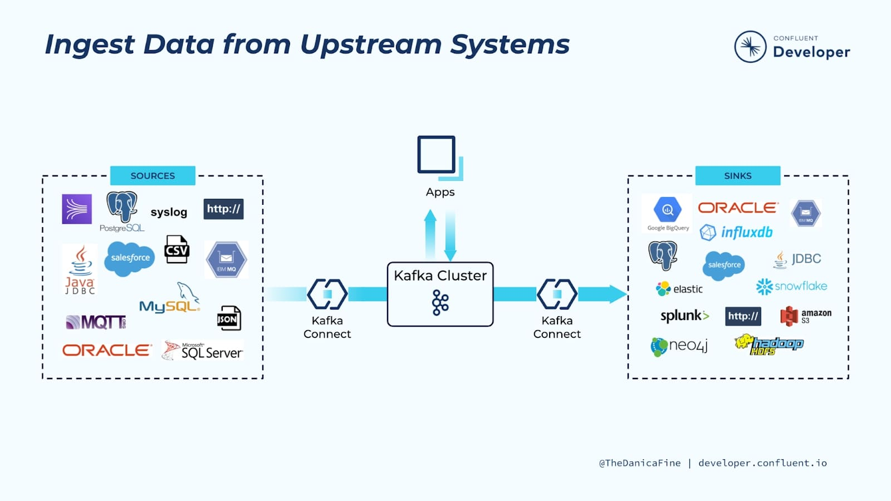

Slide 71
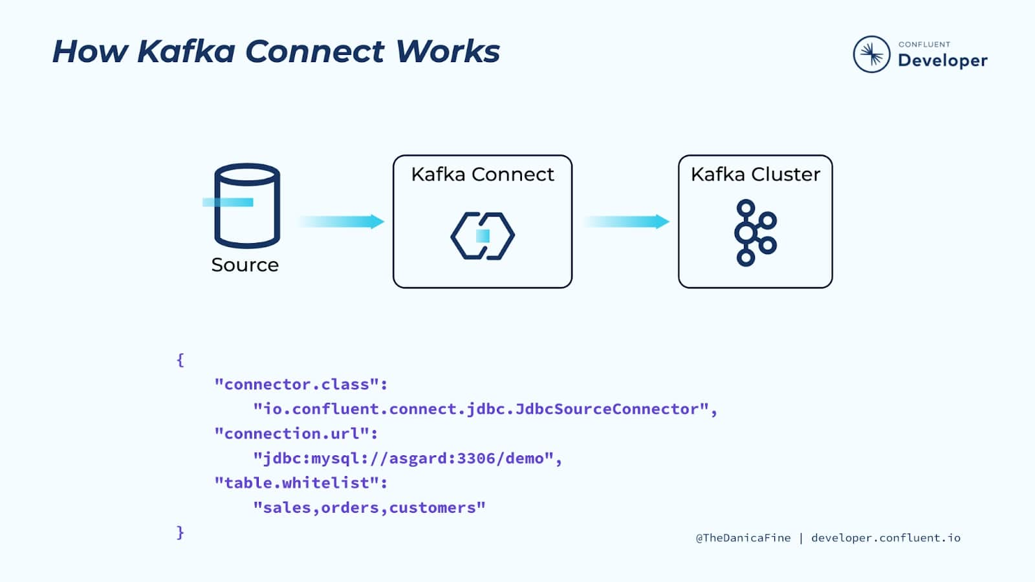

Slide 72
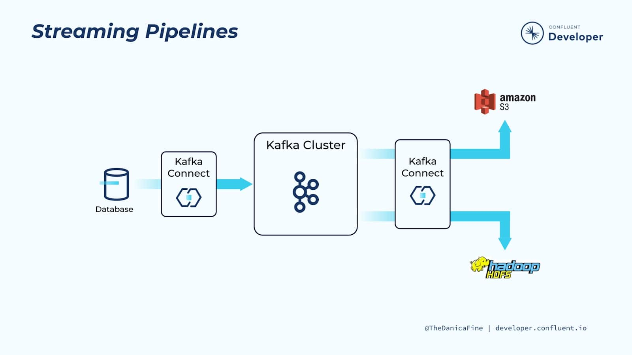

Slide 73
Schema Registry

Slide 74
What is Schema Registry?
Schema Registry is a service that provides a central repository for managing and validating schemas for Kafka messages.
Ensures that data is serialized and deserialized consistently across producers and consumers.
Defines the structure of data (e.g., Avro, JSON Schema, Protobuf).
Logical groupings of schemas, typically tied to a Kafka topic.
Schemas can evolve, and each change is tracked as a new version.
Uses Kafka Cluster as a backing store.

Slide 75
Schema Registry
Schema Registry
Fetch schema and
validate
Stores the schemas in topics
Fetch schema and
validate
Producer
Kafka Cluster
Consumer

Slide 76
Define the avro schema for event
{
"namespace": "io.devhands.avro",
"type": "record",
"name": "Event",
"fields": [
{"name": "name", "type": "string"},
{"name": "kind", "type": "string"},
{"name": "data", "type": "long"}
]
}

Slide 77
Publish the schema into registry
curl -X POST -H "Content-Type: application/vnd.schemaregistry.v1+json" \
--data '{"schema": "{\"type\": \"record\", \"name\": \"Event\", \"fields\": [{\"name\": \"name\", \"type\": \"string\"}, {\"name\": \"kind\", \"type\": \"string\"}, {\"name\": \"data\", \"type\": \"long\"}]}"}' \
http://kafka-registry:8081/subjects/event-avro/versions

Slide 78
Fetch the schema from registry
curl -X GET http:// kafka-registry:8081/subjects/event-avro/versions/latest

Slide 79
Schema Evolution and Compatibility
The process of modifying a schema over time while ensuring compatibility with existing data.
Types of Changes:
Backward: New schema can read data written by the old schema.
Forward: Old schema can read data written by the new schema.
Full Compatible: Both backward and forward compatible.
Backward is the default
curl -XPUT --data '{"compatibility":"BACKWARD"}’ \ http://…/config/event-avro

Slide 80
Best Practices for Using Schema Registry
Schema Design:
Design schemas with forward and backward compatibility in mind.
Use defaults for new fields to maintain compatibility.
Versioning:
Increment schema versions for changes.
Use meaningful versioning conventions.
Compatibility:
Regularly check compatibility mode settings.
Use full compatibility for the highest level of data integrity.

Slide 81
Best Practices for Using Schema Registry
Documentation:
Document schema changes and evolution history.
Maintain a changelog for schema updates.
Security:
Secure access to the Schema Registry API.
Use authentication and authorization to control access.

Slide 82
Kafka Mirroring
How to live with only one leg two datacenters

Slide 83
What is Kafka MirrorMaker?
A tool provided by Apache Kafka for cross-cluster replication.
Designed to replicate topics between clusters.
Common use cases:
Disaster recovery and backup.
Geo-replication for multi-region Kafka clusters.
Migration between Kafka clusters.

Slide 84
MirrorMaker 2 (MM2)
MM2 introduced with Kafka 2.4
MM2 is a major upgrade, built on top of Kafka Connect.
Key improvements over the original MirrorMaker:
Based on Kafka Connect framework.
Better configurability and modularity.
Supports active-active replication between clusters.
Enhanced monitoring and metrics support.
Handles topic renaming and automatic offset sync.

Slide 85
MirrorMaker
kafka 1
kafka 4
kafka 2
kafka 6
kafka 3
kafka 5

Slide 86
MirrorMaker
Consumer
Producer
kafka 1
kafka 4
kafka 2
kafka 6
kafka 3
kafka 5

Slide 87
MirrorMaker
Consumer
Producer
kafka 1
kafka 4
kafka 2
kafka 6
kafka 3
kafka 5
Producer
Consumer

Slide 88
MirrorMaker
Consumer
Producer
kafka 1
kafka 4
Asynchronous
kafka 2
kafka 6
kafka 3
kafka 5
Producer
Consumer

Slide 89
What is Kafka Mirroring?
The process of replicating data from one Kafka cluster (source) to another Kafka cluster (target)
Purpose:
Data availability.
Disaster recovery.
Geographic distribution.
Data locality for improved performance.

Slide 90
Setting Up MirrorMaker
# consumer.properties
bootstrap.servers=source-kafka:9092
exclude.internal.topics=true
client.id=mirror_maker_consumer
group.id=mirror_maker_consumer
# producer.properties
bootstrap.servers=target-kafka:9092
acks=all
batch.size=100
client.id=mirror_maker_producer

Slide 91
Setting Up MirrorMaker
bin/kafka-mirror-maker.sh \
--consumer.config consumer.properties \
--producer.config producer.properties \
--num.streams 3 \
--whitelist=".*"

Slide 92
Cycle Prevention Mechanisms
Topic Prefixing:
Use different prefixes for topics in each cluster.
Example: cluster-a-topic and cluster-b-topic
Message Filtering:
Use custom message handlers to filter out messages that have already been mirrored.

Slide 93
Cycle Prevention Mechanisms
./bin/kafka-mirror-maker.sh \
--consumer.config consumer-a.properties \
--producer.config producer-b.properties \
--whitelist="^cluster-a-.*” \
./bin/kafka-mirror-maker.sh \
--consumer.config consumer-a.properties \
--producer.config producer-b.properties \
--message.handler=io.devhands.CustomHandler

Slide 94
Cycle Prevention CustomHandler
public class CustomHandler implements MirrorMakerMessageHandler {
@Override
public void handle(String key, String value, RecordContext recCtx) {
// Example: Add a header to mark messages that have been mirrored
if (recCtx.headers().lastHeader("mirrored-from-cluster-a") == null) {
context().forward(key, value);
}
}
}

Slide 95
Homework
Run Streams on top of the cluster from previous homework
Create simple mapper for any of the simulated topic
Implement simple aggregate processor
Implement join processor

Slide 96
Homework
Run Streams on top of the cluster from previous homework
Create simple mapper for any of the simulated topic
Implement simple aggregate processor
Implement join processor
Could be done with Kafka Streams or any other approach

Slide 97
Demo

